Slide 1
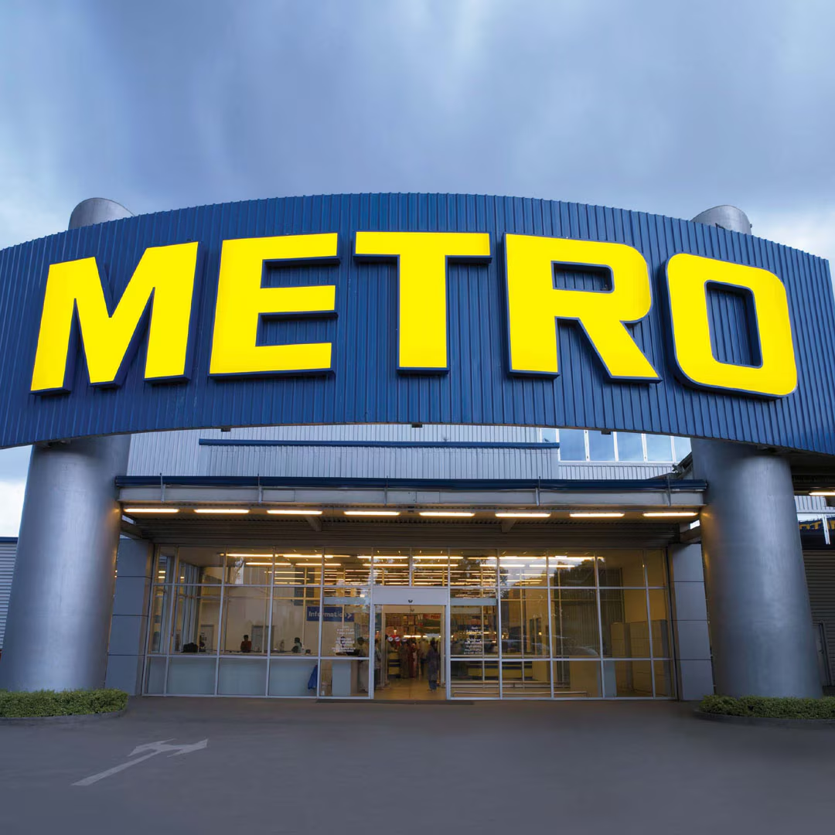
PRESENTATION
MARKETING PROJECT
Syeda Laiba Waseem
23SP-001-BA
And
Muhammad Umar
23SP-003-BA

Slide 2
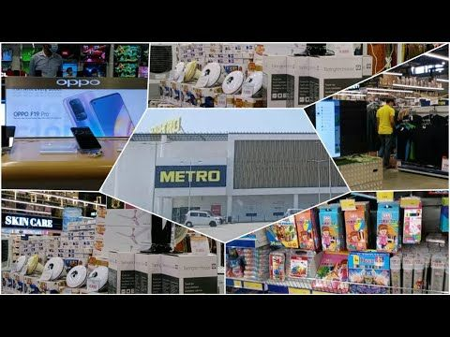
INTRODUTION:
Metro Mart is a popular retail destination in Karachi, Pakistan.
It is a trusted retail chain in Karachi, Pakistan, providing a wide variety of products for urban shoppers.
Metro opened its first store in 2007. It operates total 10 supermarkets in Karachi, Lahore, Islamabad, Faisalabad and Multan.
Mission: Enhancing shopping experience with quality products at competitive prices.
Vision: Becoming the leading retail chain in Pakistan with a customer-centric approach.

Slide 3
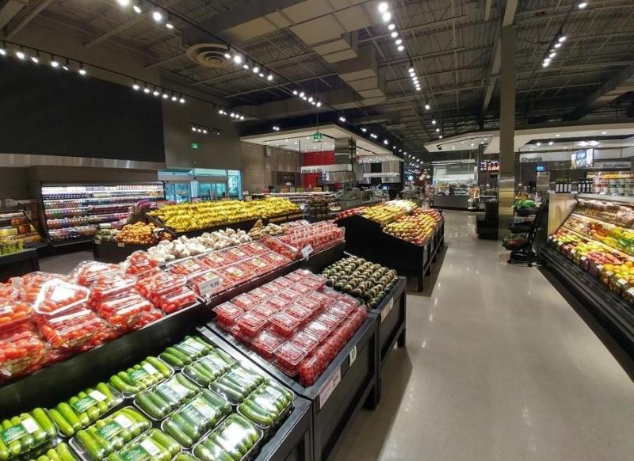
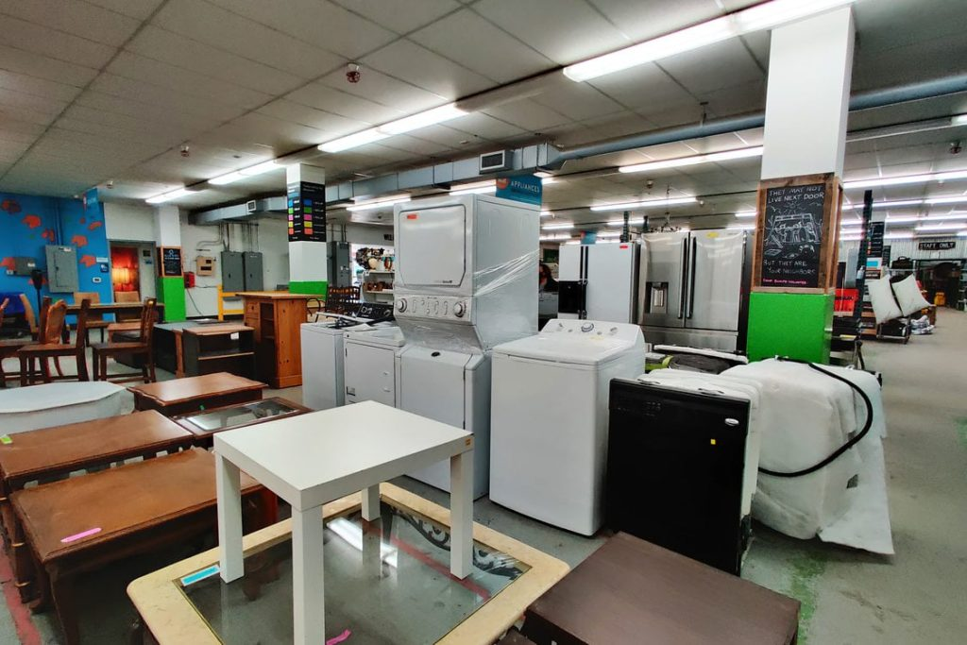
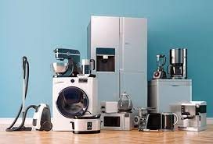
Company Overview:
01
02
03
1. One-stop shopping solution:
Providing all essential and luxury items conveniently under a single roof.
2. Wide range of products:
Offering groceries, clothing, home goods, and electronics to cater to diverse consumer needs.

Slide 4
Brand Traits:
Quality:
Reliability:
Innovation:
Commitment to offering high-standard products across all categories.
Ensuring consistent availability of products and dependable service.
Continuously improving shopping experiences and embracing new technologies.

Slide 5
Management Structure:
Operations:
01
02
Sales & Marketing:
Customer Service:
03
04
Supply Chain Management:
Finance:
05
06
IT Department:
Ensuring efficiency and customer satisfaction.
Attracting and retaining customers.
Enhancing customer experience.
Seamless sourcing and logistics.
Budgeting and financial planning.
Optimizing technological infrastructure.

Slide 6
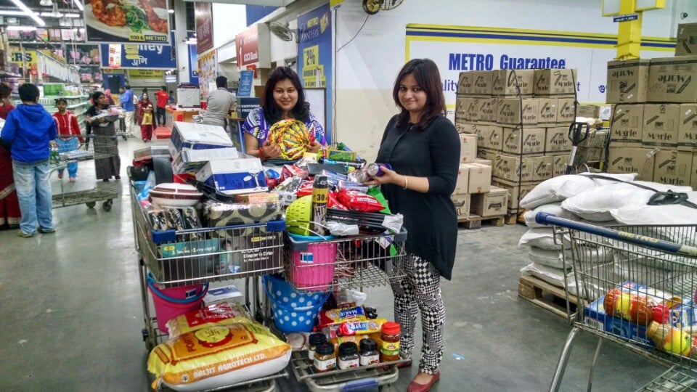
Product Sourcing & Marketing Management Orientation:
Sourcing:
Marketing Management:
Wholesale: Metro Mart sources products through wholesale channels, ensuring a diverse inventory and competitive pricing.
Customer-Oriented Approach: Metro Mart adopts a customer-centric strategy focused on understanding and fulfilling the specific needs and preferences of its customer base.

Slide 7
Target Market:
88%
B2C Model:
Directly serving individual consumers.
80%
Urban middle to upper-middle-class families:
Seeking quality and convenience.
97%
Young professionals and students:
Emphasizing affordability and trendiness.

Slide 8
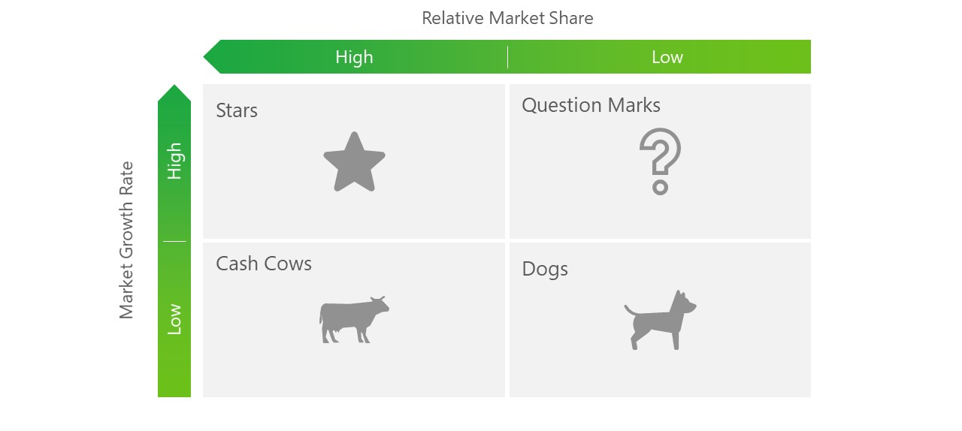
Current Business Portfolio - BCG Matrix:
Fresh produce and dairy products
Packaged foods
Electronics
Home décor items

Slide 9
Market Environment & Competitive Analysis:
Micro Environment:
Macro Environment
Competitors
Suppliers Customers Competitors Public
Natural, Technological
Political
Cultural factors
Hyperstar
Carrefour
Imtiaz Super Market

Slide 10



COMPETITOR ANALYSIS
STRENGTHS:
WEAKNESSES:
Diverse Product Range: Metro Mart offers groceries, clothing, home goods, and electronics, providing comprehensive shopping solutions.
Quality Focus: Known for high-quality products and reliable customer service.
Limited Geographic Reach: Presence in Karachi, limiting market penetration compared to national.
Digital Presence: Room for growth in online and digital marketing strategies to compete with larger retailers.

Slide 11
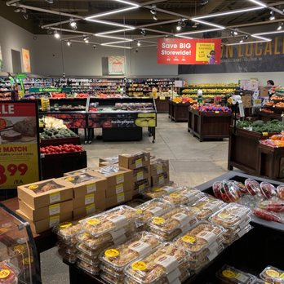
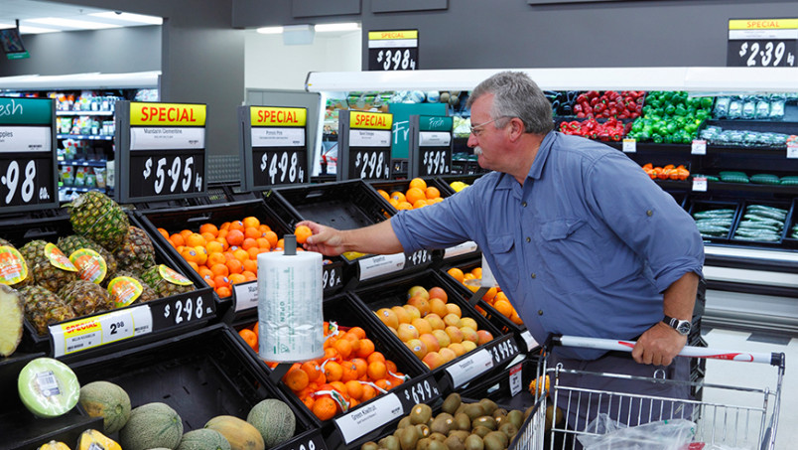
Conclusion:
Metro Mart has solidified its market leadership in Pakistan through a commitment to quality, convenience, and affordability. With a strong emphasis on customer satisfaction and continuous innovation, Metro Mart is well-prepared for future growth in the retail sector.

Slide 12
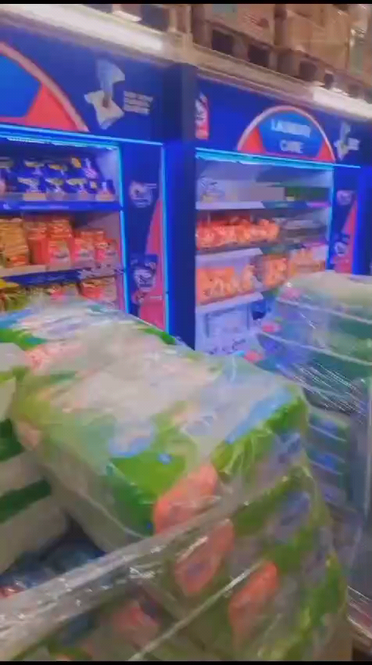

Slide 13

THANK YOU

